Slide 1


Health Monitoring System for Senior Citizens
Group Members
Javairia Rehman (P19-0020)
Matti Ur Rehman (P19-0048)
Muhammad Mohsin Raza (P19-0072)
Project Supervisor
Dr. Hafeez Ur Rehman

Slide 2



Introduction
A World is a Global Village, Right?
Also, Impossible that you are 24/7 Home, Well COVID-19 gone “ALMOST”
Someone at Home, Needs an Attention

Slide 3

Motivation
Usually, all golden agers need attention
Everyone has gone through this or has seen it in life
703 million persons aged 65 years in 2019 Globally. Projected to double to 1.5 billion in 2050
According to the U.S. Department of Health and Human Services 13.8 million non-institutional seniors live alone

Slide 4


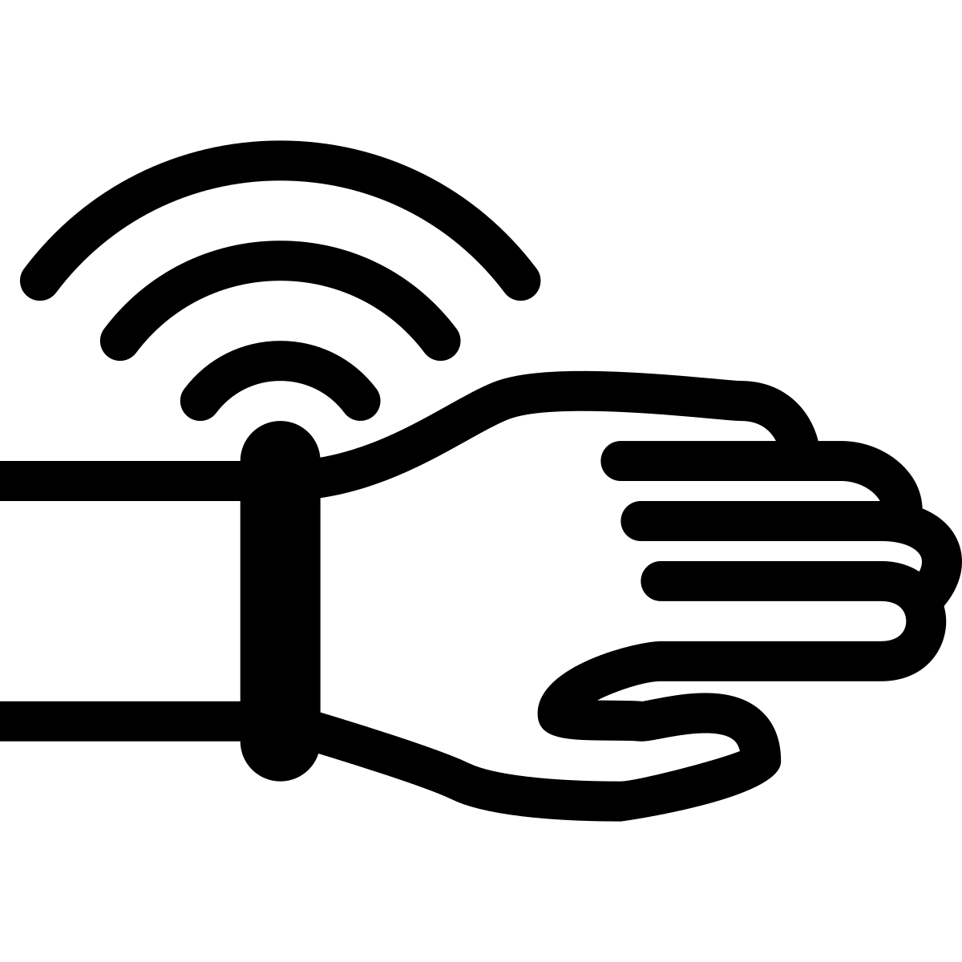
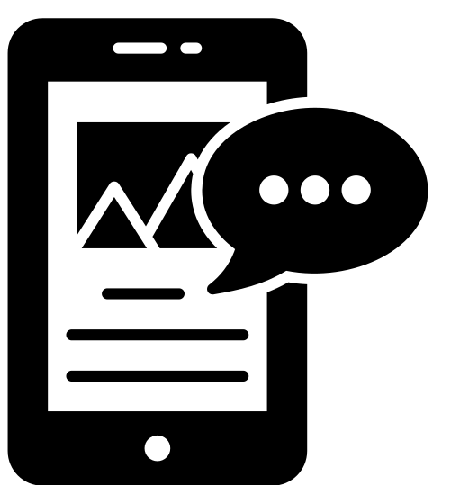
A Vision-based Device
Wearable Sensors
Health Monitoring System
A Mobile Application

Slide 5
Literature Review
Literature Reference | Basic Idea | Methodologies | Results | Limitations
Vision-based human activity recognition: a survey [1] | To provide uptodate analysis of vision-based HAR | Reviewed all previous researches in domain of HAR | HA are still facing several problems. | Do not give any solution to problems.
Going deeper into action recognition: A survey [2] | Pioneering methods to Deep learning | Investigate existing solutions for action recognition | Deep learning approaches are helpful | Does not describe cons of using DL
Sensor and vision-based HAR [3] | introduces a classification of HAR methodologies | Compare both approaches by using previous researches | HAR methods are classified into two main groups. | Don’t discuss their use

Slide 6
Literature Review
Literature Reference | Basic Idea | Methodologies | Results | Limitations
Vision-based human action recognition: An overview and real world challenges [4] | To address real-world problems | Review all methods that proposed to solve real-world problem | Proposed methods are unable to address all real-world problems | Not give any solution to real-world problems
Real-Time Elderly Monitoring for Senior Safety by Lightweight Human Action Recognition (REMS) [5] | Monitoring eldery people from distance | Using captured skeleton images, the REMS able to recognize abnormal behaviors | Able to monitor eldery people | Delay in receiving message from sensor

Slide 7

Problem Statement
An eldery people need to be monitored 24/7. If you are at work somewhere and no one is present with your parents.How would you monitor them?

Slide 8
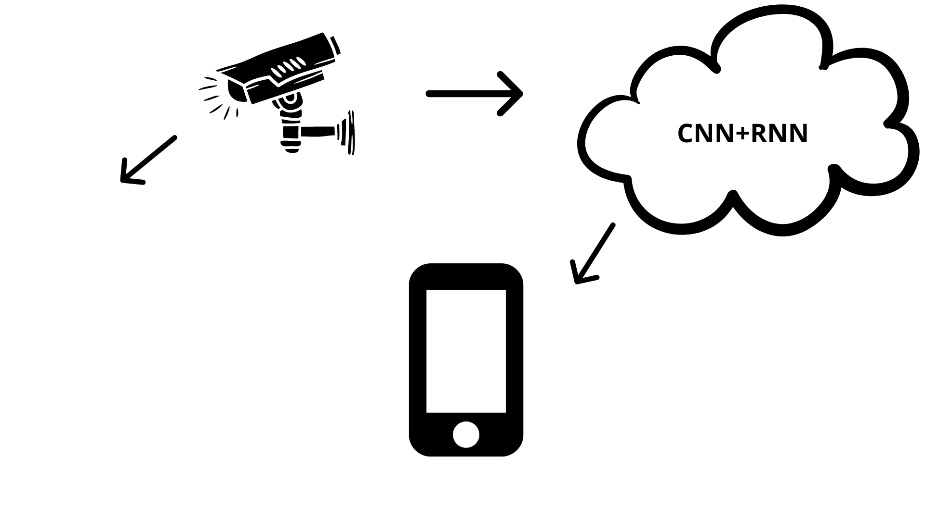
Proposed System
Fig 1.0

Slide 9

Objectives
Detection of Health-sensitive Human Activities
Alert the Relatives/Attendant/Doctors
Keep Activity log/Analytics

Slide 10

Expected Result
A monitoring app that shows the live footage as well as detects irregularities
Live sensor readings
An Assistive Tool

Slide 11
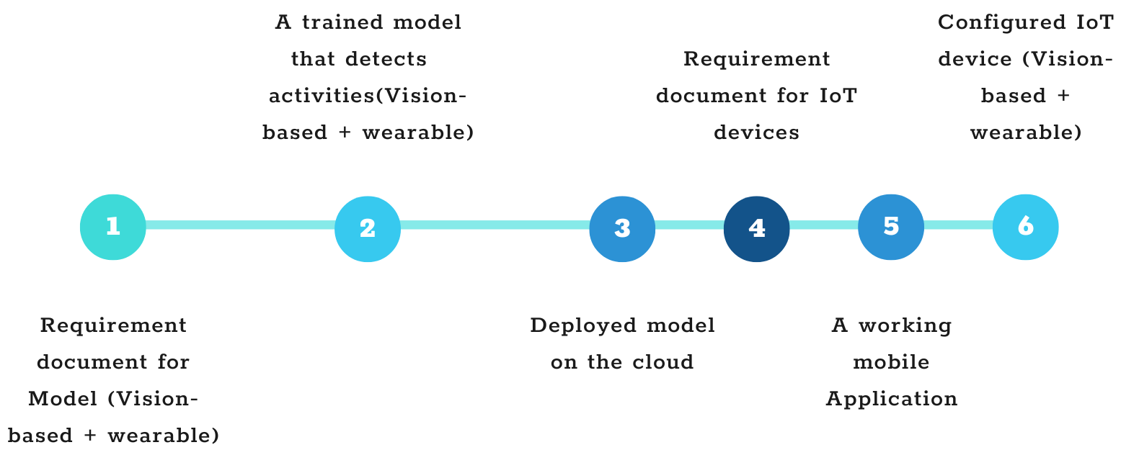
TIME LINE

Slide 12
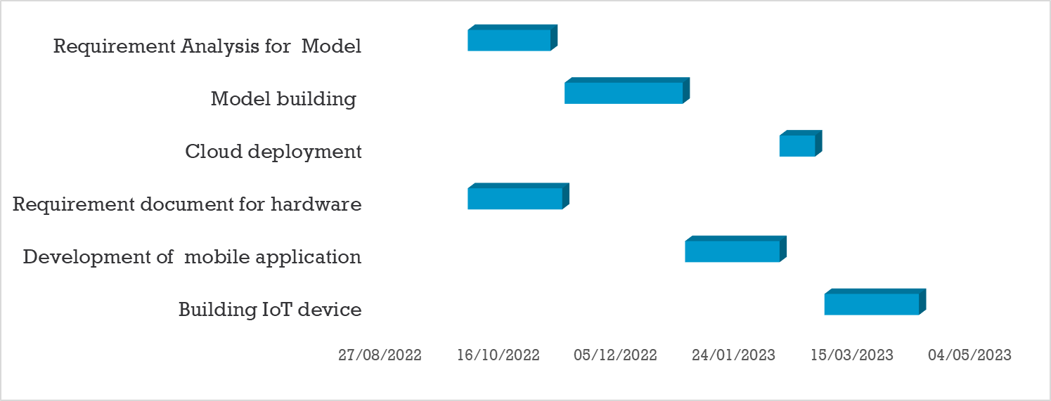
GANTT CHART

Slide 13
References
[1] Beddiar, D.R., Nini, B., Sabokrou, M. et al. Vision-based human activity recognition: a survey. Multimed Tools Appl 79, 30509–30555 (2020). https://doi.org/10.1007/s11042-020-09004-3
[2] Herath, Samitha; Harandi, Mehrtash; Porikli, Fatih (2017). Going deeper into action recognition: A survey. Image and Vision Computing, 60(), 4–21. doi:10.1016/j.imavis.2017.01.010
[3] Dang, L.Minh; Min, Kyungbok; Wang, Hanxiang; Jalil Piran, Md.; Hee Lee, Cheol; Moon, Hyeonjoon (2020). Sensor-based and vision-based human activity recognition: A comprehensive survey. Pattern Recognition, (), 107561–. doi:10.1016/j.patcog.2020.107561
[4] Jegham, I., Ben Khalifa, A., Alouani, I., & Mahjoub, M. A. (2020). Vision-based human action recognition: An overview and real world challenges. Forensic Science International: Digital Investigation, 32, 200901. doi:10.1016/j.fsidi.2019.200901
[5] Sun, Han, and Yu Chen. "Real-Time Elderly Monitoring for Senior Safety by Lightweight Human Action Recognition." 2022 IEEE 16th International Symposium on Medical Information and Communication Technology (ISMICT). IEEE, 2022.
[Fig 1.0] https://www.canva.com/
Icons: https://thenounproject.com/

